Slide 1
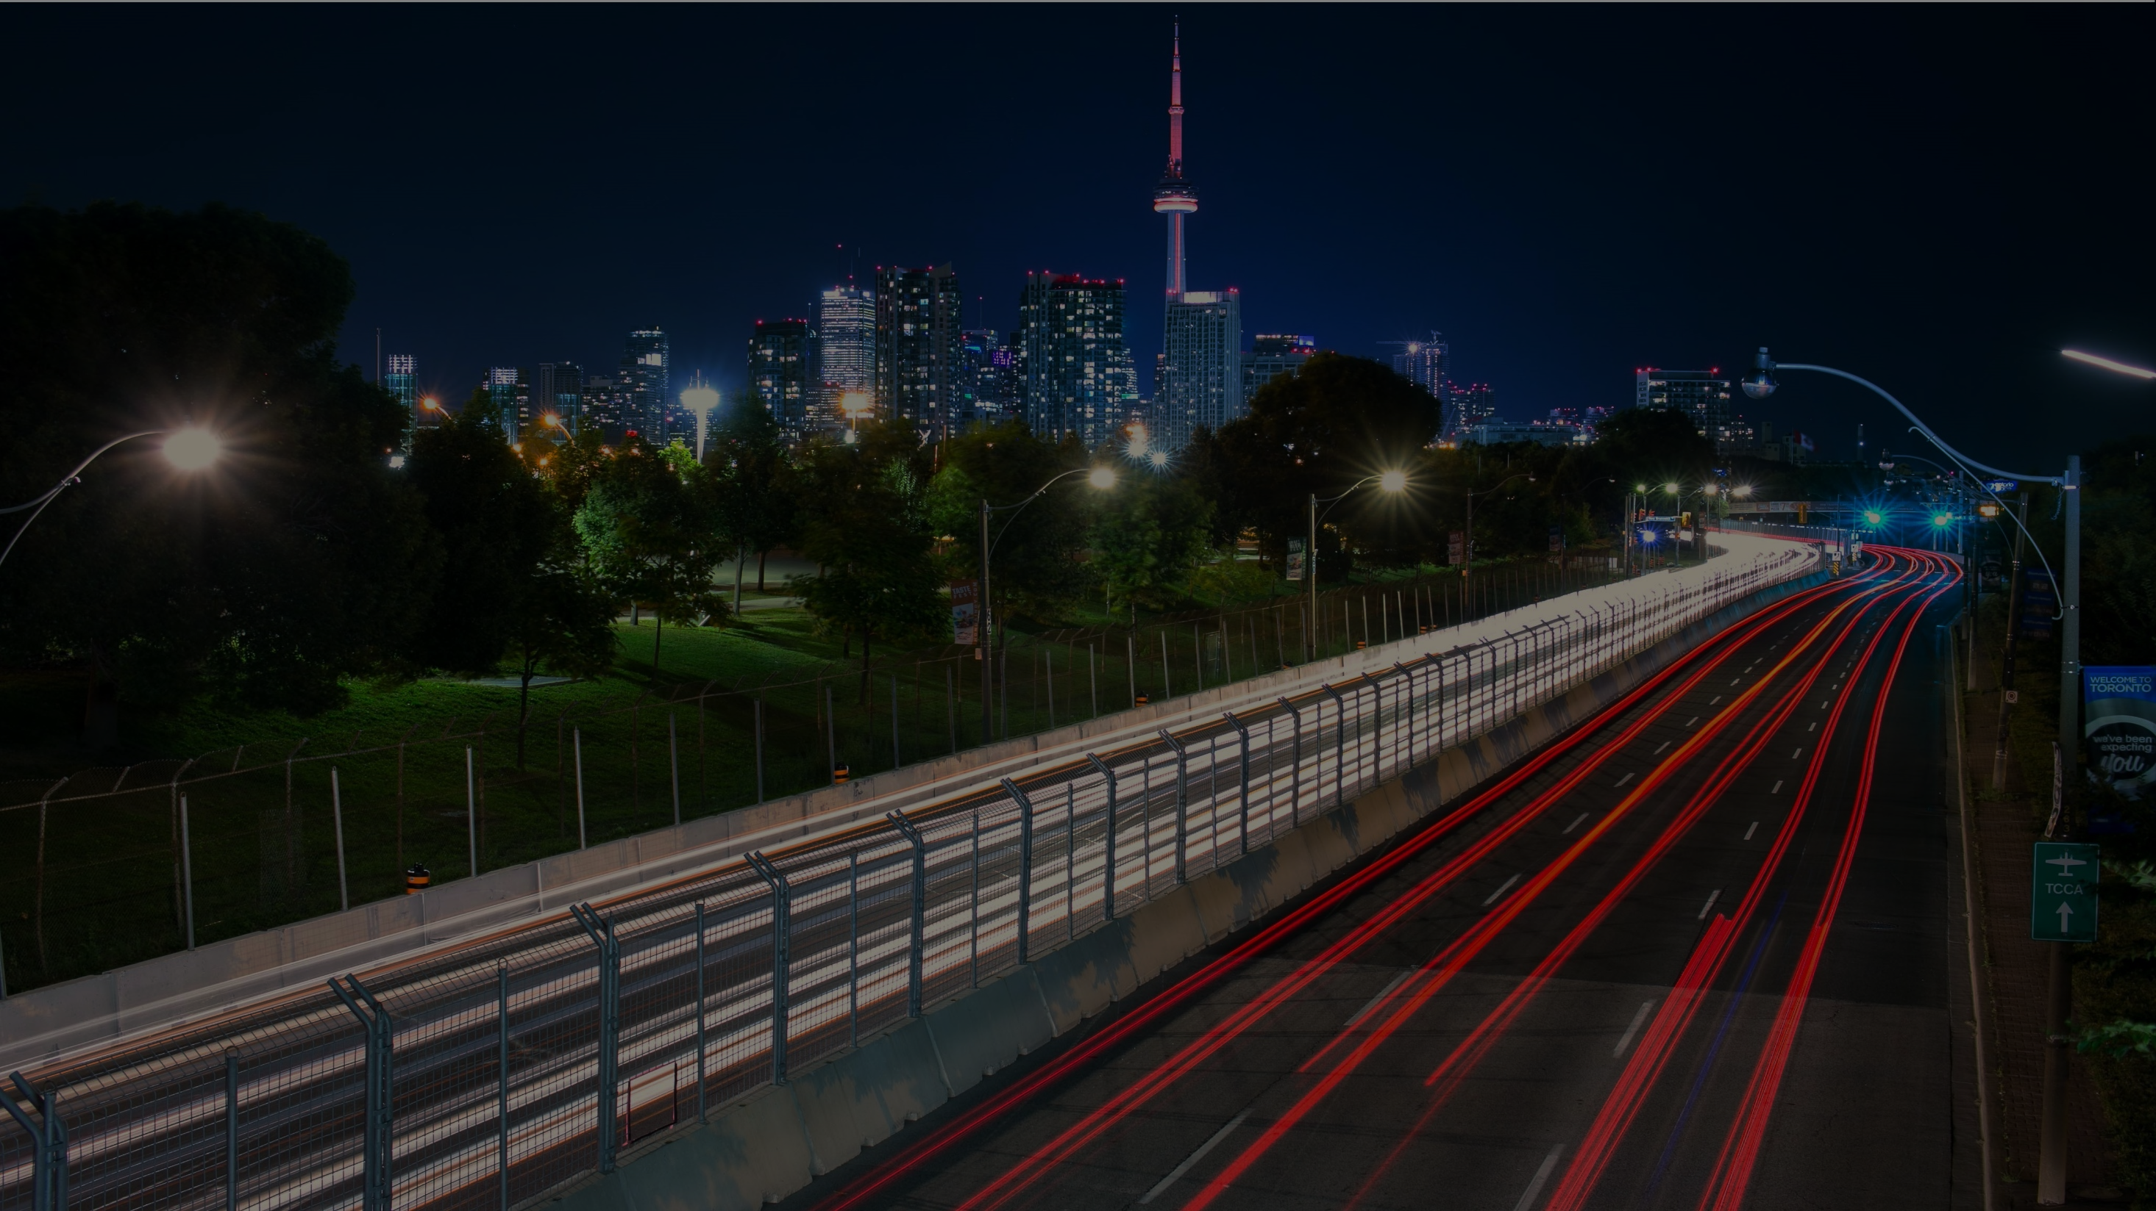
UNLOCKING GRIDLOCK ONE^PARKING SPOT AT A TIME
ILLEGAL
Traffic Jam Hackathon
Team Deloitte

Slide 2
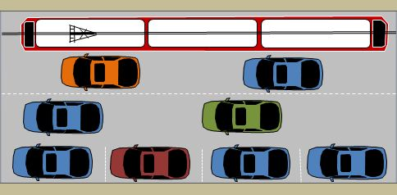

Illegal street parking on roadways is a material contributing factor to traffic congestion in the city of Toronto
Illegal parking reduces the available traffic throughput by limiting number of available traffic lanes
Traffic throughput is further impacted by vehicles having to merge from lanes blocked by illegal parking

Slide 3


Slide 4
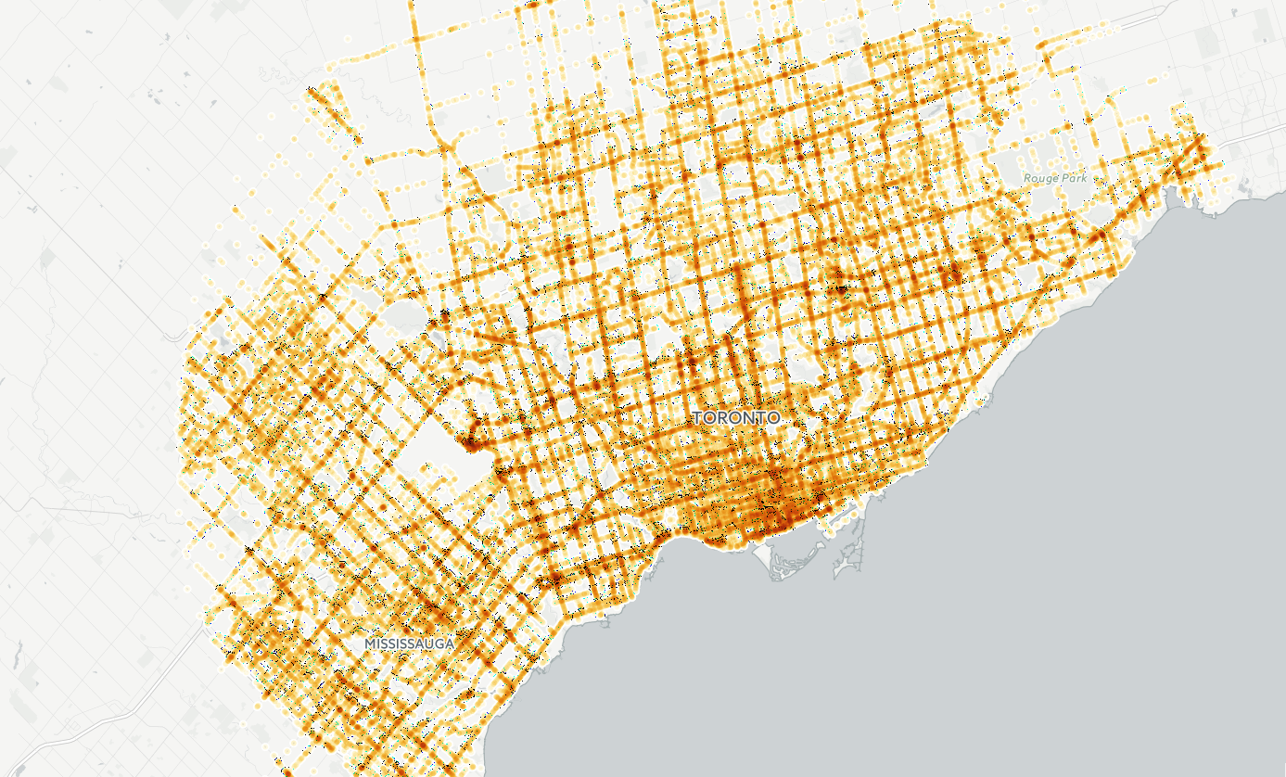
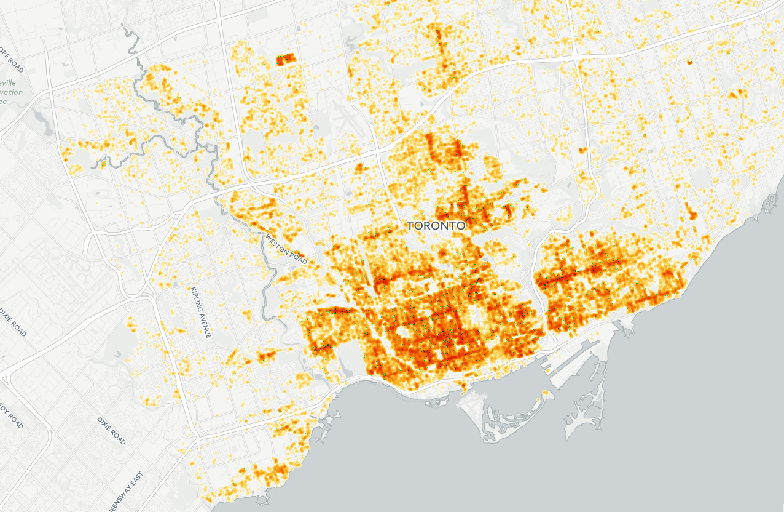
Analysis indicates that there is a strong correlation between areas of high traffic congestion within the city and prevalence of illegal street parking activities
Infraction %
In 2014, approximately 750 KMs. of City of Toronto roadways were identified as high congestion traffic areas
High Congestion
Medium Congestion
Low Congestion
In 2014, the City of Toronto issued approximately 170,000 traffic infractions related to street parking
~ 47%
of traffic infractions related to street parking occurred in High Congestion Traffic areas

Slide 5
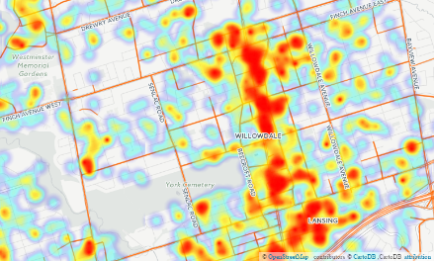
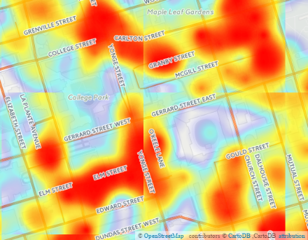
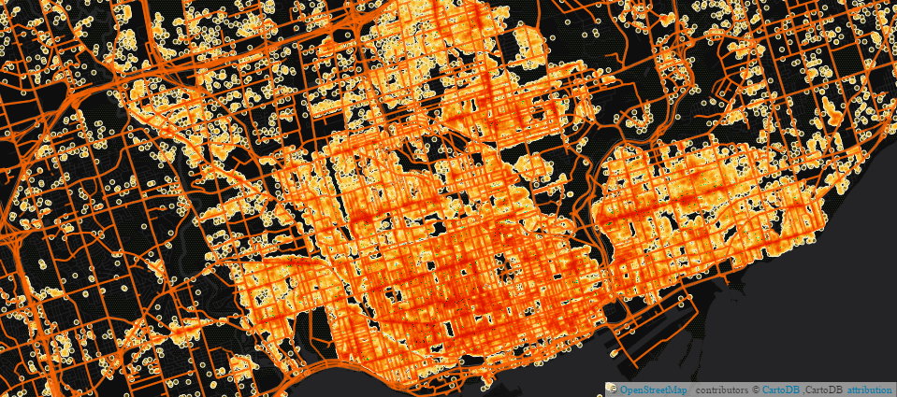
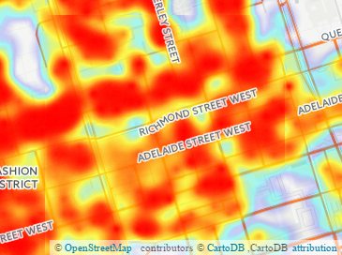
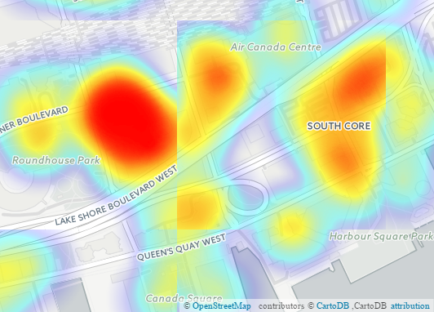
Within the City of Toronto there are specific hot spots of illegal parking and congestion
~80%
Congestion level
~170%
Congestion level
North York Centre
Danforth East
~70%
Congestion level
~90%
Congestion level
West Core
South Core
This problem is prevalent across the city of Toronto, not just the downtown core

Slide 6


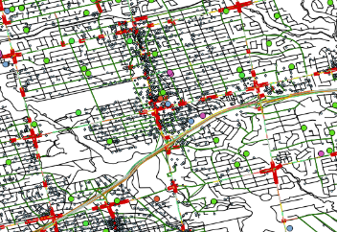
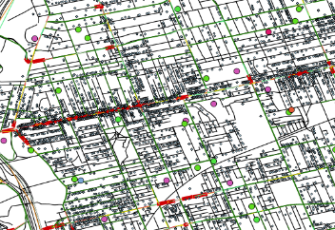


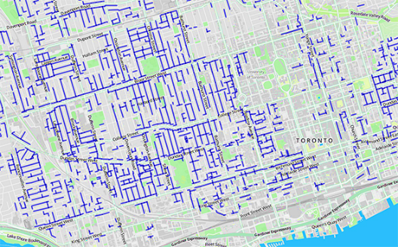


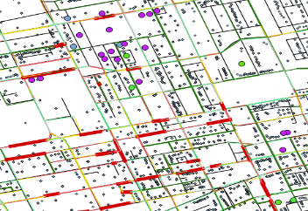
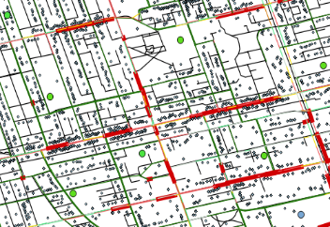


More permanent, sustainable solutions are required – there are opportunities to increase parking capacity using existing assets
In addition to reducing demand, improving access to parking information, and enforcement, there is a need to increase parking capacity
30%
15 min
of traffic consists of people “searching” for parking¹
is the average time to find parking¹
Leverage Public Assets
Leverage Private Assets
Illegal Parking Distribution
North York
Danforth East
West Core
Before 8am
8am – 4pm
After 4pm
South Core
SCHOOLS
Leverage parking facilities at public schools after hours
LANEWAYS
2400+ publicly owned laneways; 250 km of space²
Innovative business models leveraging private parking capacity coupled with governance can increase overall capacity

Slide 7
Reference: Analysis Methodology
Align
Generate
Analyze
Visualize
Create data assets
Develop metrics
Generate insights
Create maps
Sourced data from namara.io, Toronto Open Data and TomTom, including parking infractions, congestion and community assets
Geocoded parking infraction data, filtered (i.e., non-relevant infraction types) and matched data sets
Overlaid 2014 parking infraction and congestion data sets in GIS
Computed parking infractions within 100m of each road segment observation
Established statistical correlation between congestion and parking infractions across ~150k road segment observations
Identified road segments to prioritize – those with many parking infractions and congestion greater than model predictions
Validated findings through visual exploration
Overlaid and identified community assets to leverage for capacity near prioritized road segments

Slide 8
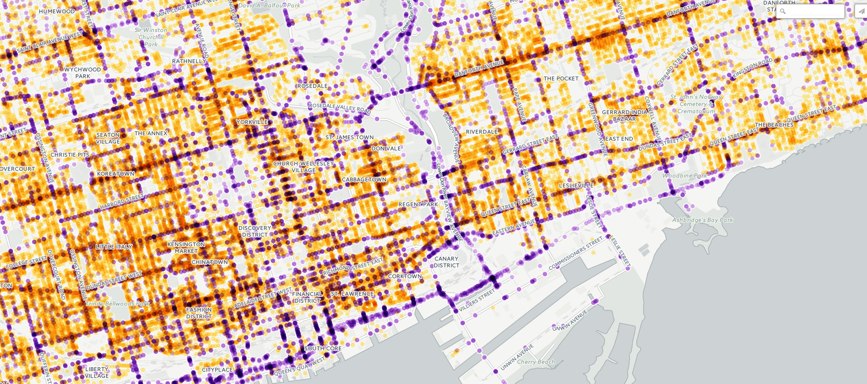
Reference: Link to SPATIAL ANALYSIS Maps
Click on Image to be redirected:

Slide 9
THANK YOU.

